Slide 1


Autonomous Drone Navigation and Object Recognition
Aishwarya.A[192225114]

Slide 2
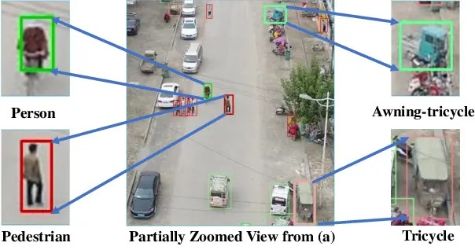
INTRODUCTION
The rapid advancement of technology has ushered in a new era of autonomous systems, particularly in the field of drones. Autonomous drones are equipped with the ability to navigate complex environments and perform various tasks without human intervention. This capability is significantly enhanced by deep learning techniques, which enable drones to recognize and interpret objects in real-time. Deep learning, a subset of machine learning, utilizes neural networks with multiple layers to analyze and process data, making it particularly suited for tasks involving visual perception and decision-making.

Slide 3
APPLICATIONS
Agriculture: Drones equipped with object recognition can monitor crop health, assess soil conditions, and even assist in precision farming by identifying pests and diseases.
Surveillance and Security: Drones can autonomously patrol designated areas, recognizing potential threats or unusual activities, thereby enhancing security measures.
Delivery Services: Companies are leveraging drones for the delivery of goods. Object recognition helps in identifying delivery locations and avoiding obstacles during flight.
Disaster Management: In disaster-stricken areas, drones can assist in search and rescue operations by recognizing people, vehicles, or hazards, providing real-time data to emergency responders.

Slide 4
METHODOLOGY
The methodology for implementing autonomous drone navigation and object recognition typically involves several key steps:
Data Collection:
Collecting large datasets of images and videos from various environments where the drone will operate.
This data should include different lighting conditions, weather conditions, and perspectives.
Preprocessing:
Cleaning and annotating the collected data to ensure high-quality input for training.
Techniques such as normalization, resizing, and data augmentation are applied to enhance the dataset.

Slide 5
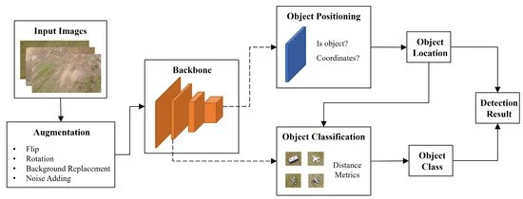

Slide 6
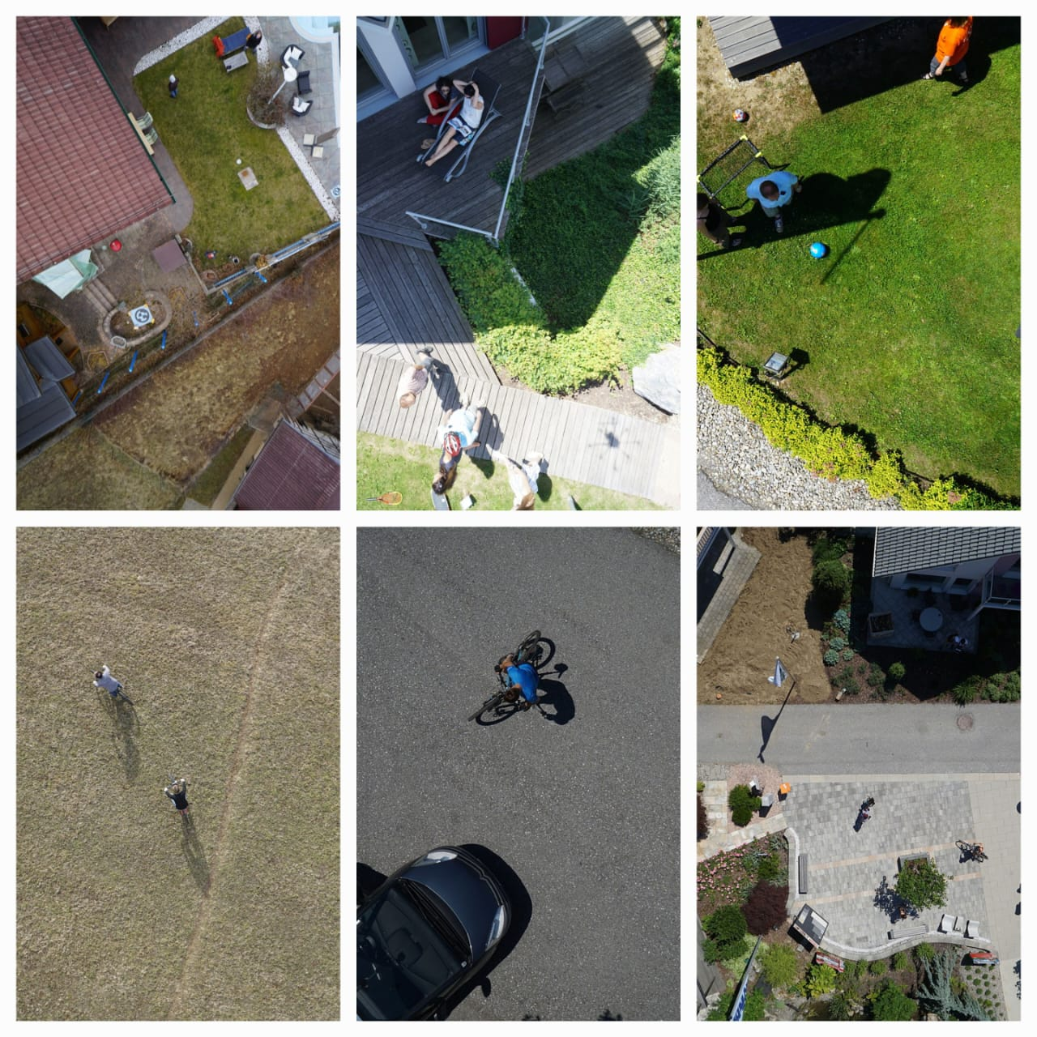
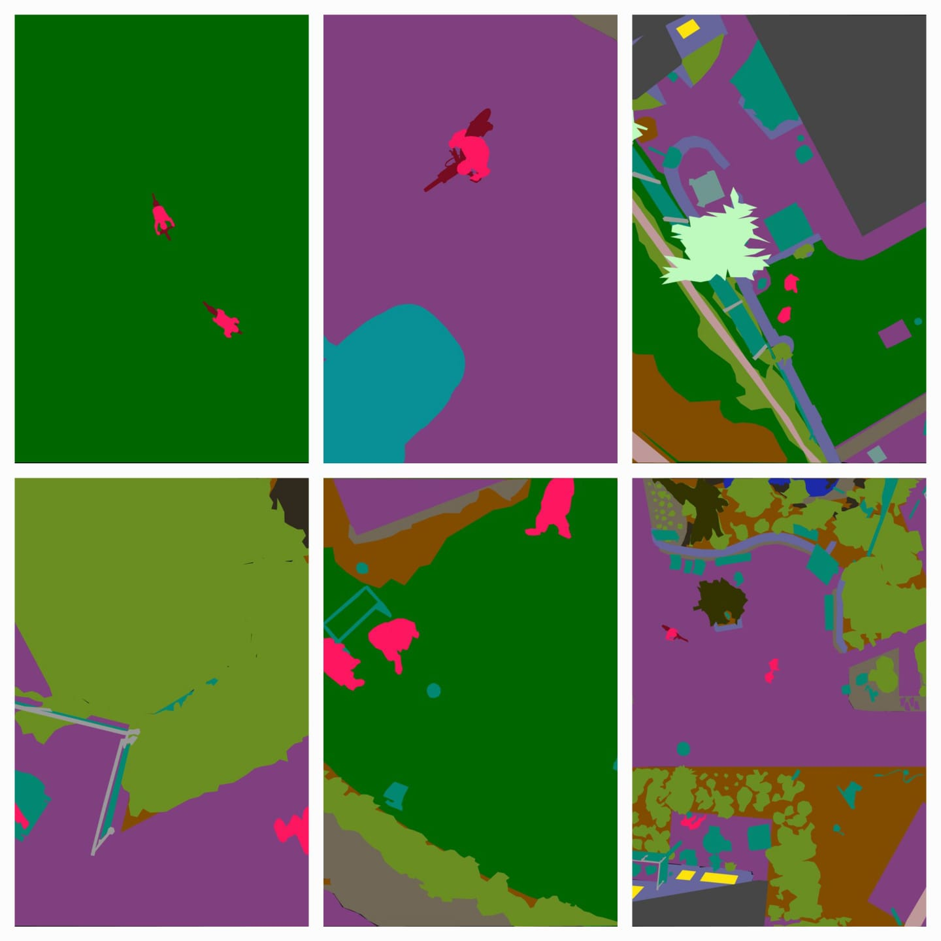


DATASET

Slide 7
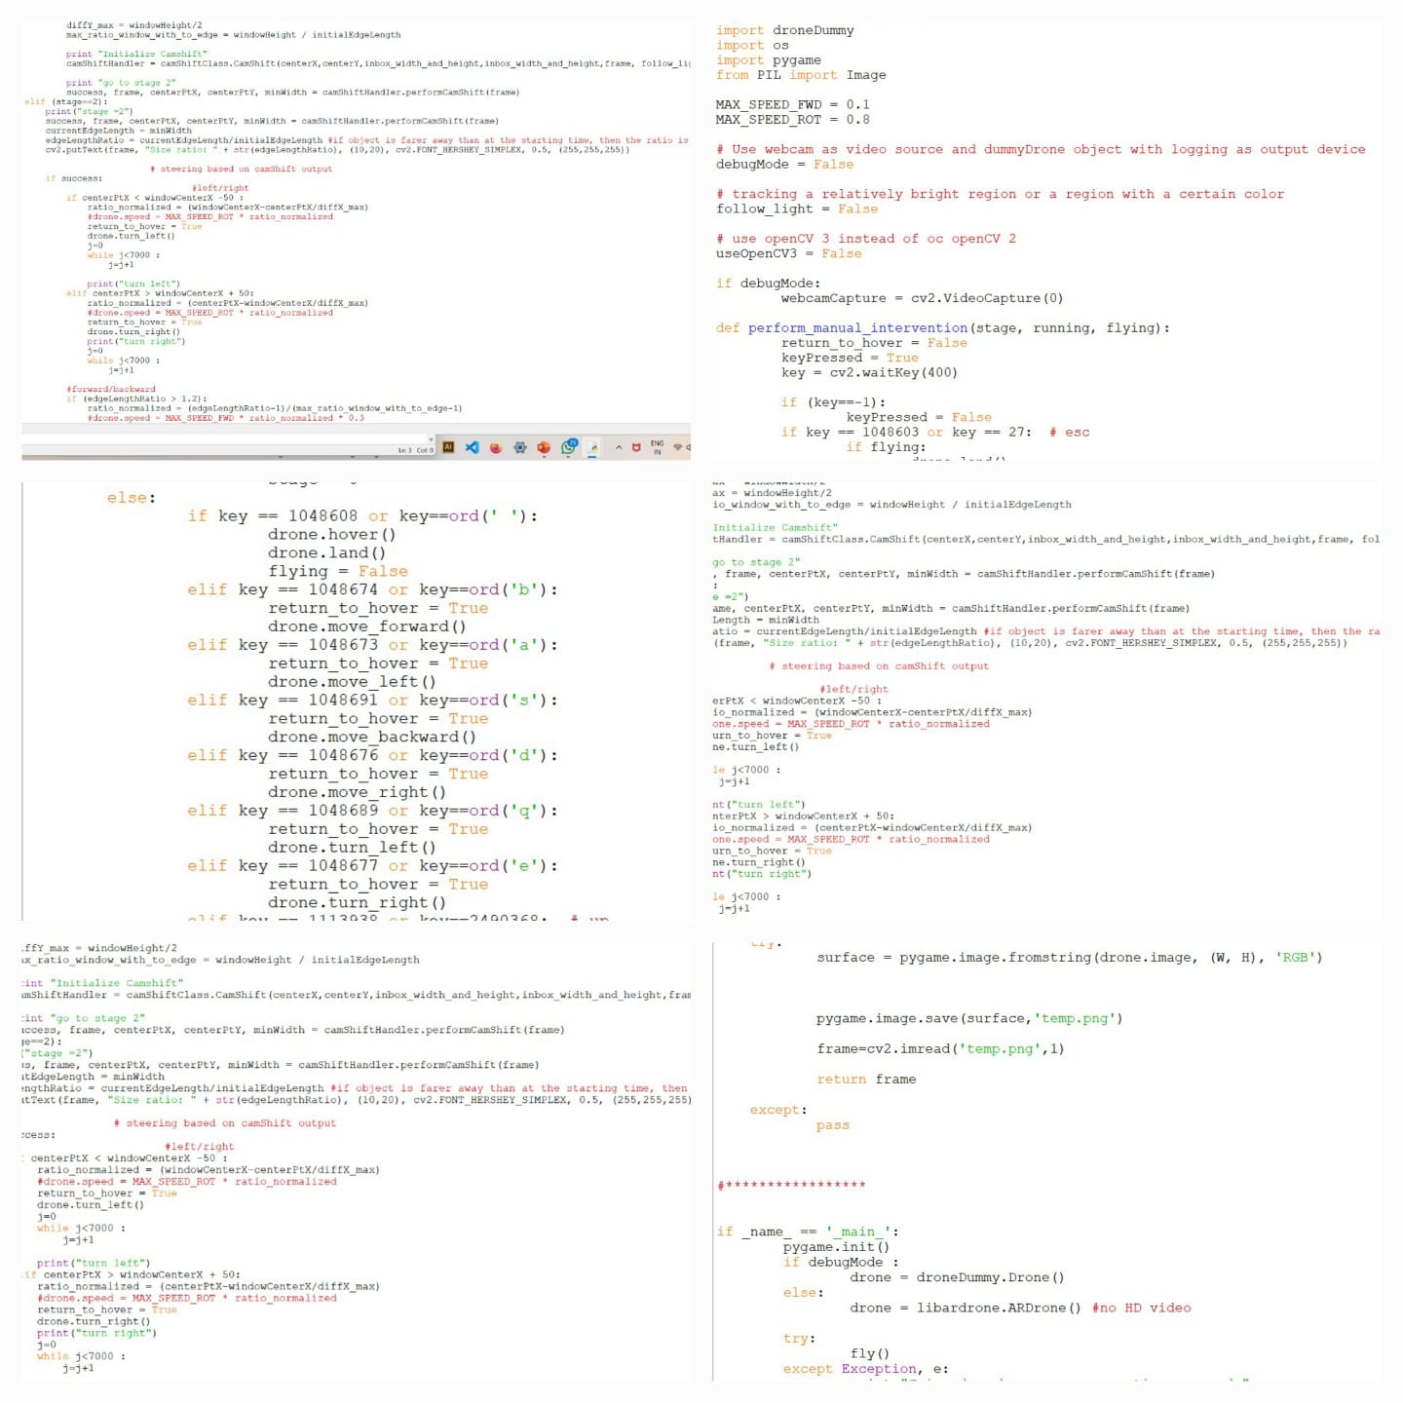
PYTHON CODE

Slide 8
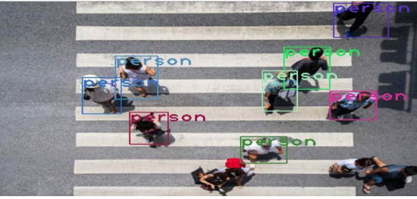
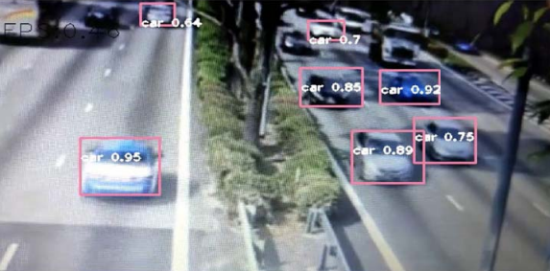
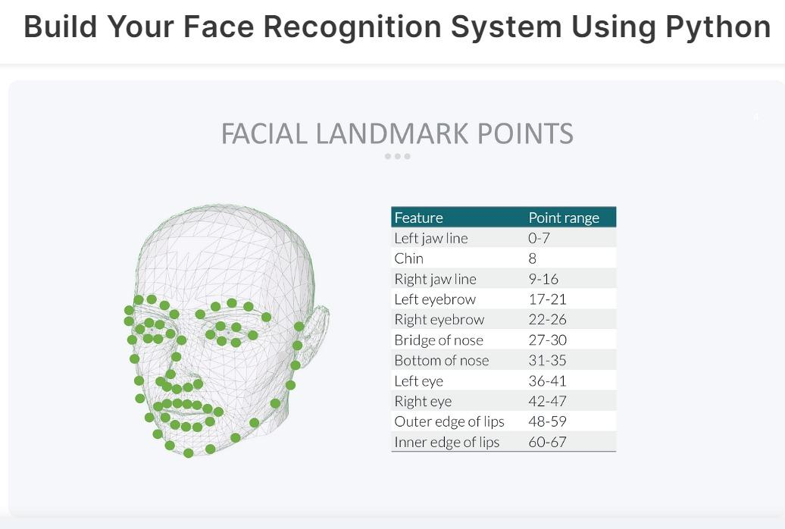
OUTPUT

Slide 9
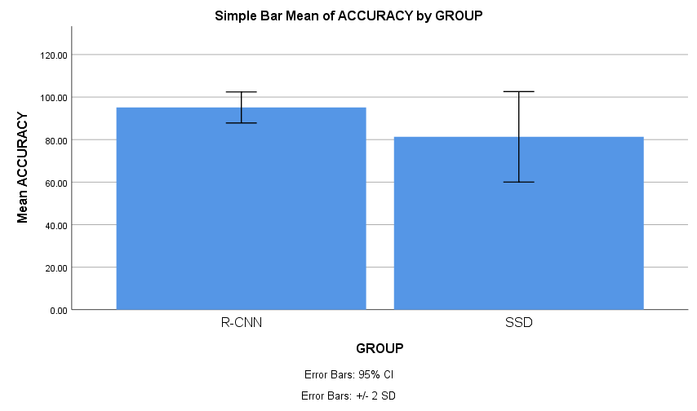
RESULT
R-CNNs are particularly well-suited for image processing tasks like image recognition due to their ability to automatically learn hierarchical patterns and features from raw pixel data.
R-CNNs are typically used for feature extraction in image recognition systems, while It is a real-time object detection algorithm that can detect multiple objects in an image with high accuracy. The SSD algorithm is based on a deep convolutional neural network (CNN) that takes an image as input and produces a set of bounding boxes and class predictions for all objects in the image.

Slide 10
DISCUSSION-01
What challenges are associated with integrating computer vision and deep learning algorithms for object recognition in a real-time drone environment?

Slide 11
Challenges
Limited computational resources: Drones have limited processing power and memory, making it challenging to run complex algorithms in real-time.
Real-time processing: Object recognition tasks require quick processing of visual data, which strains the drone's limited computational resources.
Environmental variability: Real-world environments vary in lighting, weather, and background clutter, challenging the algorithms' robustness.
Limited training data: Training machine learning models requires large labeled datasets, which can be difficult and expensive to collect for diverse scenarios.
Adaptability to new objects: Algorithms must generalize to new objects and adapt to variations not seen during training, ensuring robust performance in the field.

Slide 12
DISCUSSION-02
How can the drone effectively navigate through dynamic and unpredictable environments, adapting to changes in real-time?

Slide 13
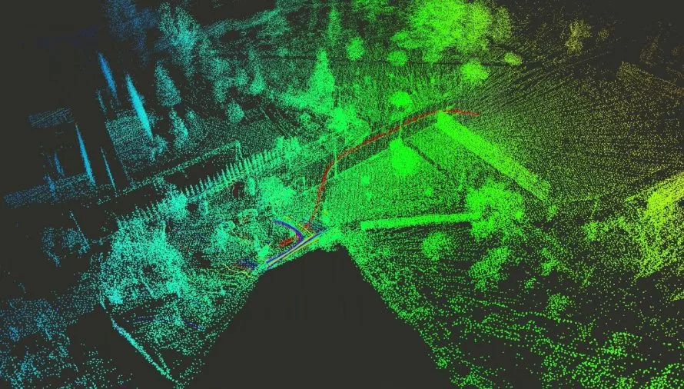
Simultaneous Localization and Mapping (SLAM) is a technique used by robots and autonomous systems, including drones, to create a map of an unknown environment while simultaneously determining their own position within that environment.
Localization: The drone estimates its own position relative to the environment using sensor data like GPS.
Mapping: Simultaneously, the drone builds a map of the environment based on sensor data, such as laser scans, camera images, or depth measurements from lidar sensors.
Integration: As the drone moves through the environment, it continuously updates both its position estimate and the map, integrating new sensor measurements while correcting for errors in its position estimate and map.

Slide 14
DISCUSSION-03
What strategies can be employed for effective communication between the autonomous drone and a ground control system, and how can remote monitoring be implemented?

Slide 15
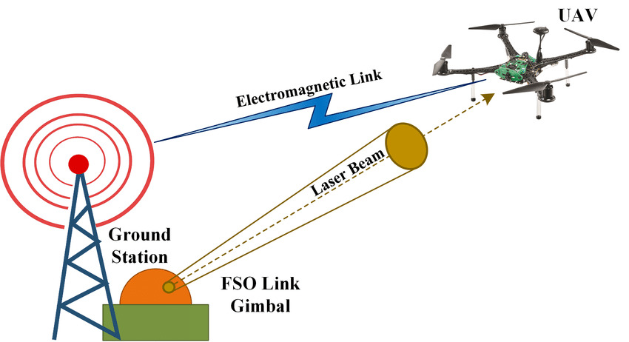
1)Wireless Communication Protocols:
Utilize reliable wireless communication protocols such as Wi-Fi, Bluetooth, or radio frequency (RF) communication
2) Telemetry Data Transmission:
Implement telemetry systems to transmit essential data such as GPS coordinates, altitude, battery status, and sensor readings from the drone to the ground control station.
3)Fail-Safe Mechanisms:
Implement fail-safe mechanisms that enable the drone to autonomously return to a predetermined location or execute predefined safety procedures in case of communication loss with the ground control system.
4)Integration with Cloud Services: Integrate the ground control system with cloud services for storing and processing data collected by the drone.

Slide 16
DISCUSSION-04
What role does deep learning play in continuously improving the drone's object recognition capabilities over time?

Slide 17
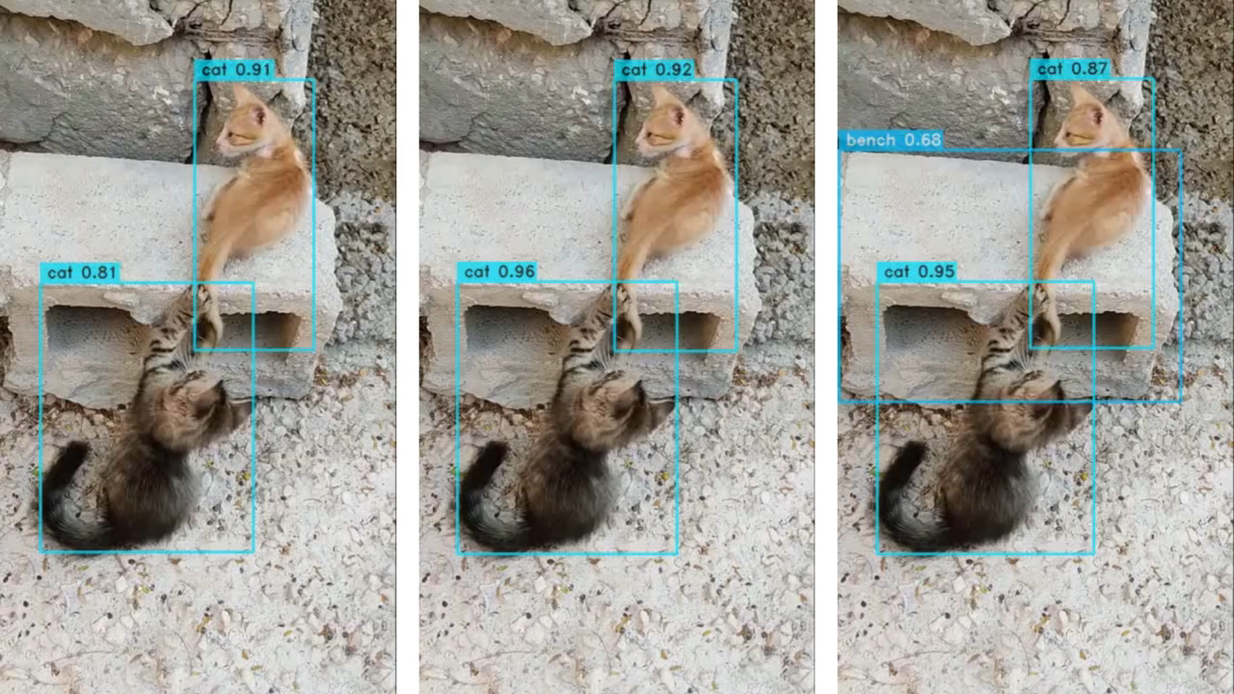
Training Data Generation: Machine learning algorithms require large amounts of labeled data to train accurate object recognition models. Drones can collect data during their missions, which can be used to continuously update and expand the training dataset.
Model Training and Optimization: Machine learning techniques, such as convolutional neural networks (CNNs) and deep learning, can be employed to train object recognition models on the collected data. These models are optimized iteratively to improve accuracy and efficiency in identifying objects.

Slide 18
Incremental Learning: Drones can utilize incremental learning techniques where the model is continuously updated with new data without retraining the entire model from scratch. This allows the drone's object recognition capabilities to improve over time as it encounters new objects or scenarios.
Adaptive Algorithms: Machine learning algorithms can adapt to changes in the environment or new types of objects by adjusting their parameters or updating the model's architecture. This adaptability ensures that the drone can recognize a wide range of objects accurately, even in dynamic or unfamiliar settings.
Feedback Loop: Drones can leverage a feedback loop mechanism where the performance of the object recognition system is continuously evaluated during operation. Misclassifications or errors can be used as feedback to further refine the model, leading to continuous improvement in object recognition accuracy over time.

Slide 19
CONCLUSION
The integration of deep learning into autonomous drone navigation and object recognition presents exciting opportunities across various sectors. As technology continues to advance, the potential applications are vast, with the promise of increased efficiency, safety, and innovation in tasks ranging from agricultural monitoring to disaster response. The methodology outlined provides a comprehensive approach to developing robust autonomous systems capable of operating in complex environments.

Slide 20
REFERENCES
Z. Zhang, W. Zhan, Z. He, and Y. Zou, “Application of spatio-temporal context and convolution neural network (CNN) in grooming behavior of Bactrocera minax (Diptera: trypetidae) detection and statistics,” Insects, vol. 11, no. 9, p. 565, 2020.
W. Zhan, I. Ramatov, W. Cui et al., “Survey of deep learning target detection algorithms based on candidate regions,” Journal of Yangtze University, vol. 16, no. 5, pp. 108–115, 2019.
X. Hui, B. Jiang, Y. Yu, X. Zhao, and M. Tan, “A novel autonomous navigation approach for UAV power line inspection,” in Proceedings of the 2017 IEEE International Conference on Robotics and Biomimetics (ROBIO), Macau, China, December 2017.
R. Jain, R. Kasturi, and B. G. Schunck, Object Recognition, Machine Vision, McGraw-Hill, NY, USA, 1995.
F. Wen, Z. Zhang, K. Wang, G. Sheng, and G. Zhang, “Angle estimation and mutual coupling self-calibration for ULA-based bistatic MIMO radar,” Signal Processing, vol. 144, pp. 61–67, 2018.
F. Wen and J. Shi, “Fast direction finding for bistatic EMVS-MIMO radar without pairing,” Signal Processing, vol. 173, Article ID 107512, 2020.
J. C. van Gemert, C. R. Verschoor, P. Mettes, K. Epema, L. P. Koh, and S. Wich, “Nature conservation drones for automatic localization and counting of animals,” Computer VisionECCV 2014 Workshops, vol. 8925, pp. 255–270, 2015.
P. Rudol and P. Doherty, “Human body detection and geolocalization for UAV search and rescue missions using color and thermal imagery,” in Proceedings of the 2008 IEEE Aerospace Conference, Big Sky, MT, USA, March 2008.

